Slide 1

PRESENTS
DATAQUEST

Slide 2
OUTLINE OF THE WORKSHOP
Introduction to Data Science
What is machine learning?
How to design a machine learning model
Supervised learning
Unsupervised learning
Evaluation Metrics
Models to predict human emotions from an image
Summary
DataQuest Quiz!

Slide 3
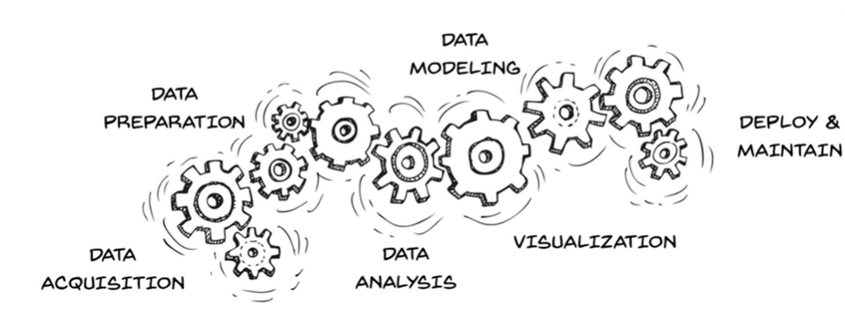
INTRODUCTION TO DATA SCIENCE
A multidisciplinary field that uses scientific processes, algorithms and systems to extract knowledge and insights from structured and unstructured data.
A "concept to unify statistics, data analysis, machine learning and their related methods" in order to "understand and analyze actual phenomena" with data.
Employs techniques and theories drawn from many fields within the context of mathematics, statistics, computer science, and information science.

Slide 4
WHAT IS MACHINE LEARNING?
A branch of Artificial Intelligence which focuses on mimicking human’s ability to learn and make decisions.
Train models that can make accurate predictions without human intervention.
Machine learning is used in the field of data science to uncover key patterns and insights with the help of various statistical methods and algorithms.
Deep learning is an extension of machine learning which makes use of multiple layered networks.
Deep learning methods are used to identify complex patterns in unstructured data like images,audio,text etc

Slide 5
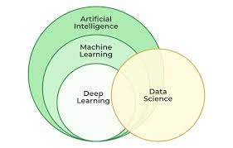

Slide 6
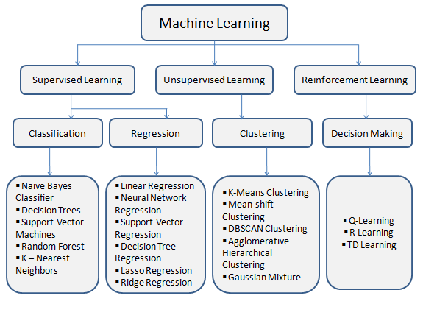
MACHINE LEARNING ALGORITHMS

Slide 7
HOW TO DESIGN A MACHINE LEARNING MODEL
Identify the problem statement.
Depending on the type of problem and given dataset choose an appropriate algorithm.
Preprocess the data to fill missing values,remove noise in the dataset and scale the data if necessary.
Perform exploratory and statistical analysis to gain insights from the dataset.
Choose the most relevant features to train the model.
Split the training dataset into train and validation sets.In this step,instead of using the whole dataset for training,we split the data so that a part of it can be used for testing accuracy of the model.
Test the model on a new dataset .
Check if the model is under fitting or over fitting.

Slide 8
Under Fitting: Both train and test accuracy are low. The model is said to have high variance.To overcome under fitting use more data,add regularization parameters and remove unwanted features.
Overfitting: The model performs well on training dataset but poorly on the test dataset.The model is said to have high bias. To overcome this add more features ,try creating synthetic data and use cross validation.
Fine tune the model parameters to improve accuracy.
Evaluate the model using appropriate metrics.
Deploy the model.
Keep monitoring and updating the model to ensure its performance does not deteriorate over time.

Slide 9
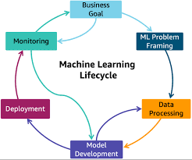
MACHINE LEARNING CYCLE

Slide 10
SUPERVISED LEARNING
The model is trained on well labeled data.
Accuracy of the model depends on how well the model can make predictions on new data.
Include both regression and classification.
Regression algorithms are used to predict continuous values.
Eg: Sales prediction of a company
Classification algorithms predict or classify discrete values.
Eg: Identify if mails are spam or not spam.

Slide 11
UNSUPERVISED LEARNING
Unsupervised learning algorithms are used to analyze and cluster unlabelled data
The algorithms find hidden patterns and predict the possible outcome.
Clustering algorithms process raw data and classify them into groups by finding similarities.
Since the model is not trained on labeled data,it would not have any idea of the features.
The main task is to identify significant features.
Eg: Google News make use of clustering methods to group relevant articles together.

Slide 12
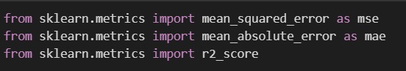
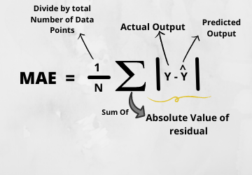
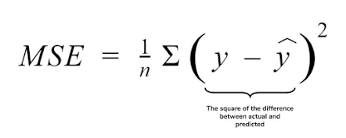
EVALUATION METRICS
REGRESSION
MEAN ABSOLUTE ERROR
MEAN SQUARED ERROR
R2-SCORE

Slide 13
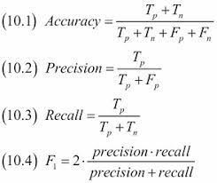
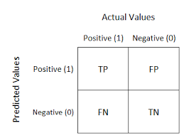
CLASSIFICATION
ACCURACY
F1 SCORE(Harmonic mean of Precision and recall)
CONFUSION MATRIX
A FEW TERMINOLOGIES:
TRUE POSITIVE: Both prediction and actual value is Yes
TRUE NEGATIVE: Both prediction and actual value are NO
FALSE POSITIVE:Prediction is yes,actual value is NO
FALSE NEGATIVE: Prediction is no,actual value is YES

Slide 14
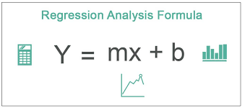
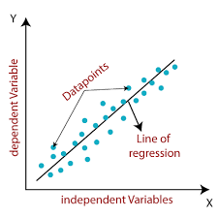
LINEAR REGRESSION
Predicts the value of a variable(dependent variable) using other variables(independent variables).
Fits a straight line that tries to minimize the difference between predicted and actual output values.
Simple linear regression model uses least squares method to discover the best fit line.
Provides simple mathematical formulas to generate predictions
Eg: Predict the price of a house by analyzing house sales data in a particular area

Slide 15
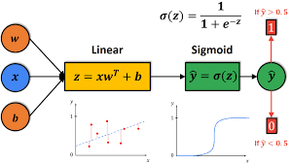
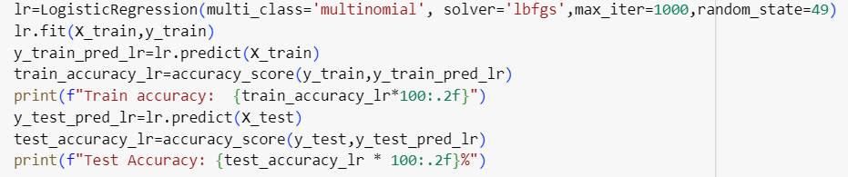
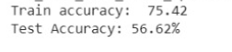
LOGISTIC REGRESSION
Supervised learning algorithm used for classification tasks.
Unlike linear regression,it predicts the probability of an instance to belong to a specific class using sigmoid function.
Gives binary output( 0 or 1).
For multi class classification, multinomial logistic regression is used.
In multinomial logistic regression,the problem is transformed into multiple binary classification problems.

Slide 16
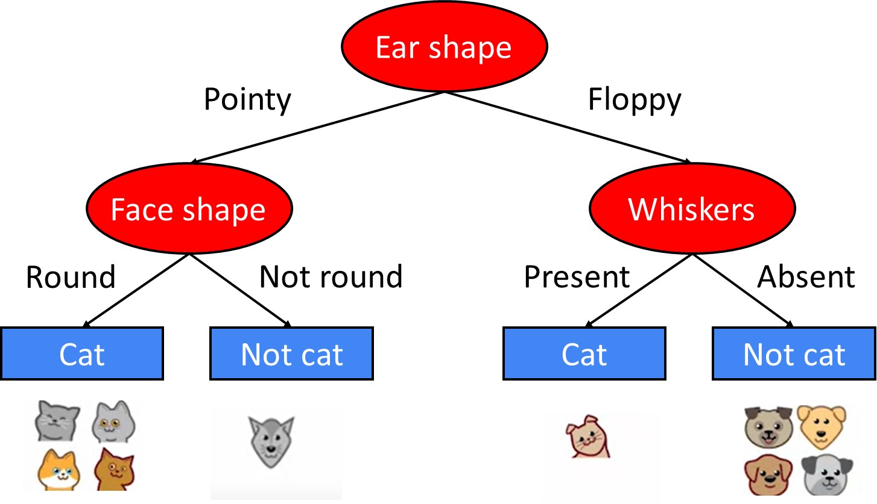
DECISION TREES
Supervised learning algorithm for both regression and classification tasks.
It is a tree structured classifier where nodes represent features and branches represent decision rules.
Decision nodes make the decisions while leaf nodes are the outcomes of the decisions made.
Categorical decision trees are used for classification.
Continuous variable decision trees are used for regression where the answer cannot be a yes or no.

Slide 17
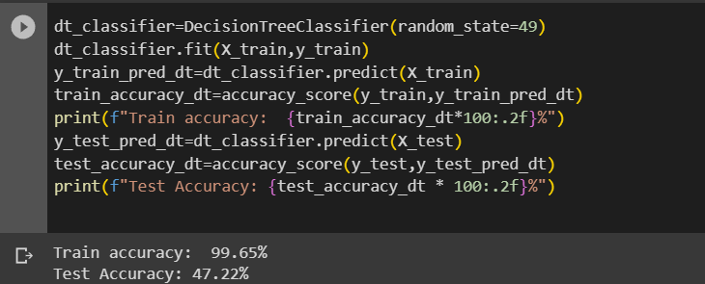
Two important steps to design a decision tree include choosing the best feature from dataset and deciding where to stop splitting the nodes.
The best attribute is the one that will reduce the randomness in data after the split.
The best attribute is chosen using methods like gini impurity and information gain.
The whole dataset gets split based on the best attribute at the root node.
Splitting continues until the node in a class is completely pure or the number of examples in a node are below a certain threshold.
Highly efficient for classification tasks.

Slide 18
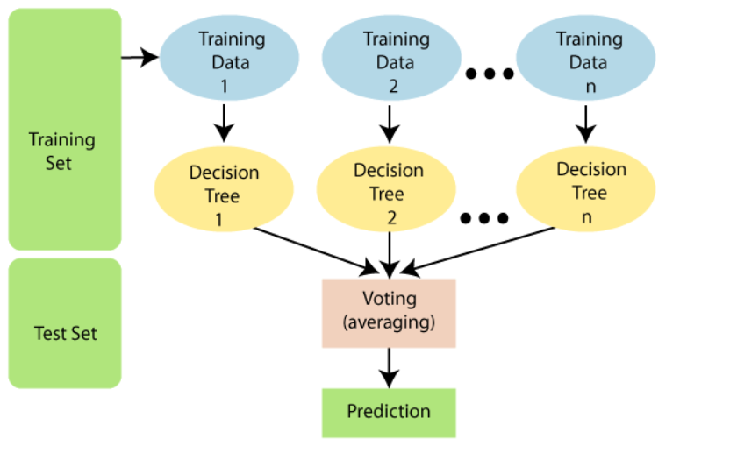
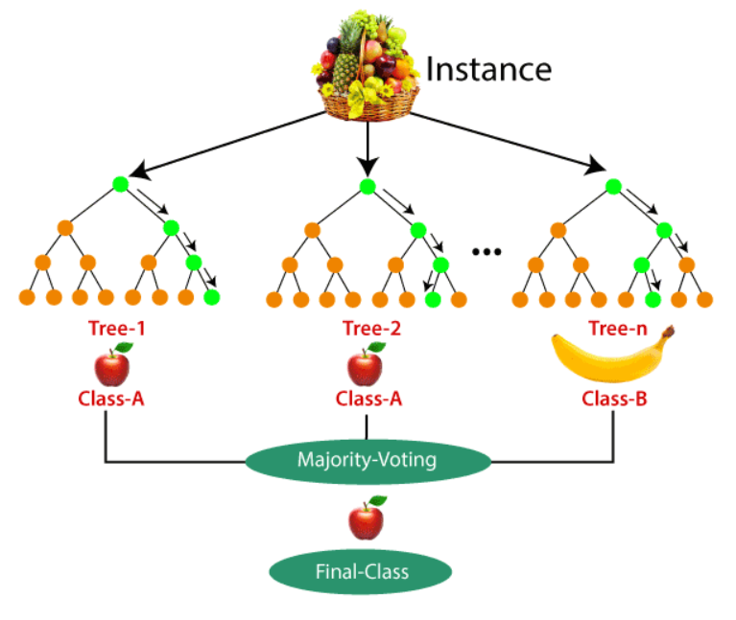
RANDOM FOREST CLASSIFIER
Random Forest is an ensemble method that combines multiple decision trees to enhance prediction accuracy.
Random Forest employs bagging, creating multiple tree models with bootstrapped subsets of the training data to reduce overfitting.
It uses random feature subsets at each split in the trees to enhance diversity and reduce correlation between trees.
For classification, it uses a majority vote, and for regression, it takes the average of predictions from individual trees.
Random Forests are less prone to overfitting compared to single decision trees, making them more robust.

Slide 19
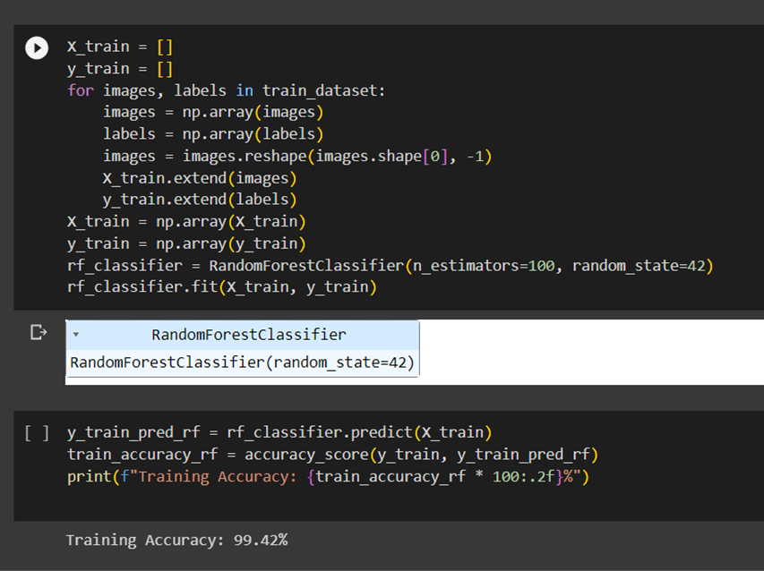
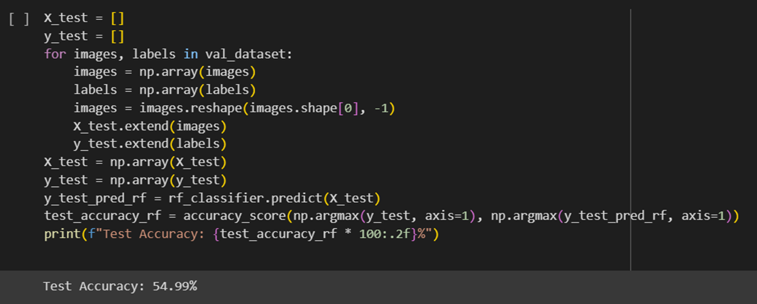
More Training Accuracy --------> Overfitting
More Training Accuracy --------> Less Test Accuracy
Less Training Accuracy ----------> Underfitting
Less Training Accuracy doesn’t necessarily mean more Test Accuracy.

Slide 20
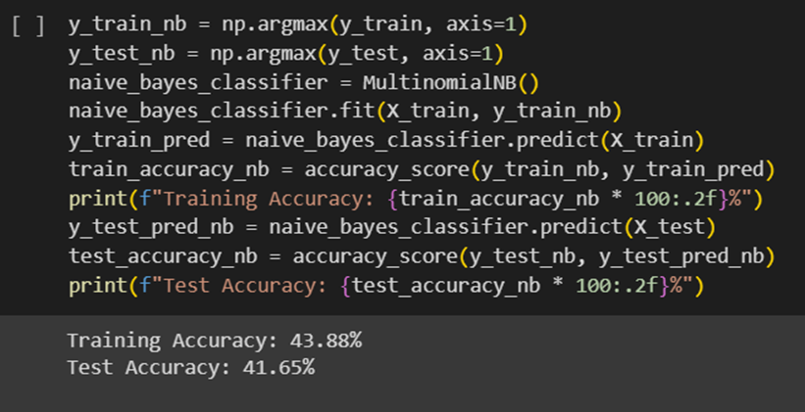
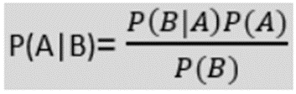
NAIVE BAYES CLASSIFICATION
Naïve Bayes is a supervised classification algorithm based on Bayes' theorem.
Well-suited for text classification.
Fast and effective predictions.
Utilizes probability for classification.
Used in spam filtering, sentiment
analysis, and so on.
P(A|B) is Posterior probability: Probability of hypothesis A on the observed event B.
P(B|A) is Likelihood probability: Probability of the evidence given that the probability of a hypothesis is true.

Slide 21
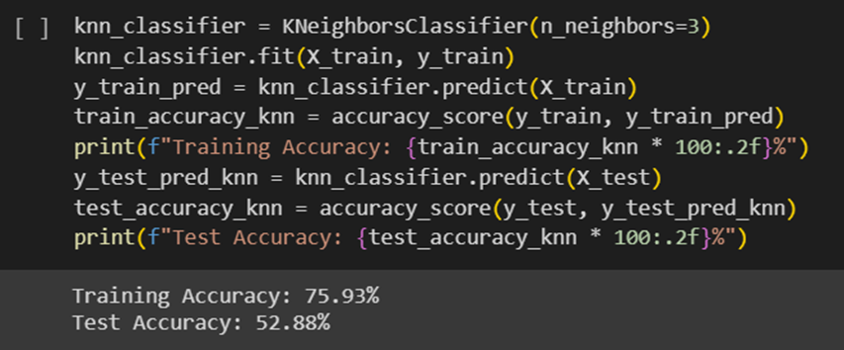
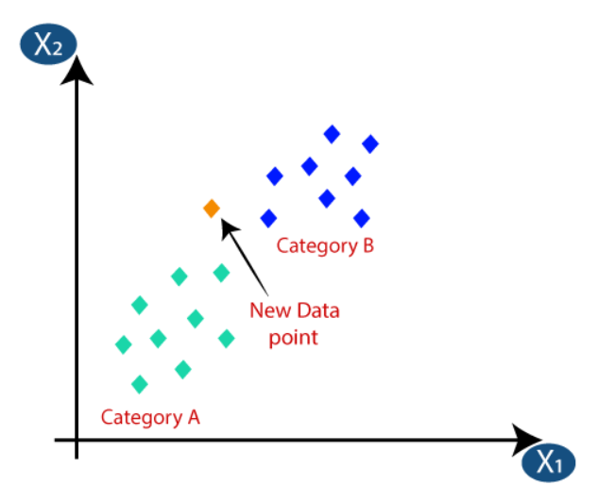
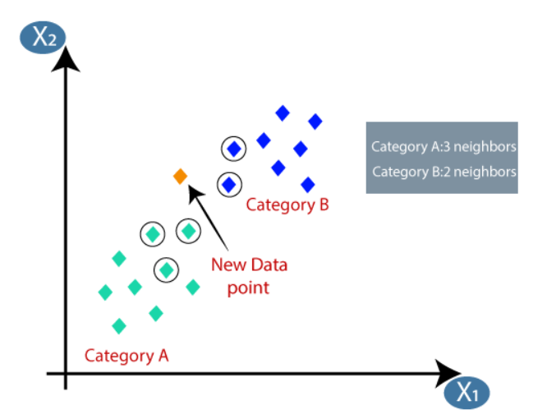
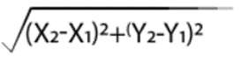
K NEAREST NEIGHBOURS
•Supervised learning algorithm.
•Categorizes new data based on similarity to existing data points.
• Stores all available data and classifies only during time of classification, also known as “lazy learner”.
• It's primarily used for classification but can handle regression.
Euclidean Distance between 2 data points

Slide 22
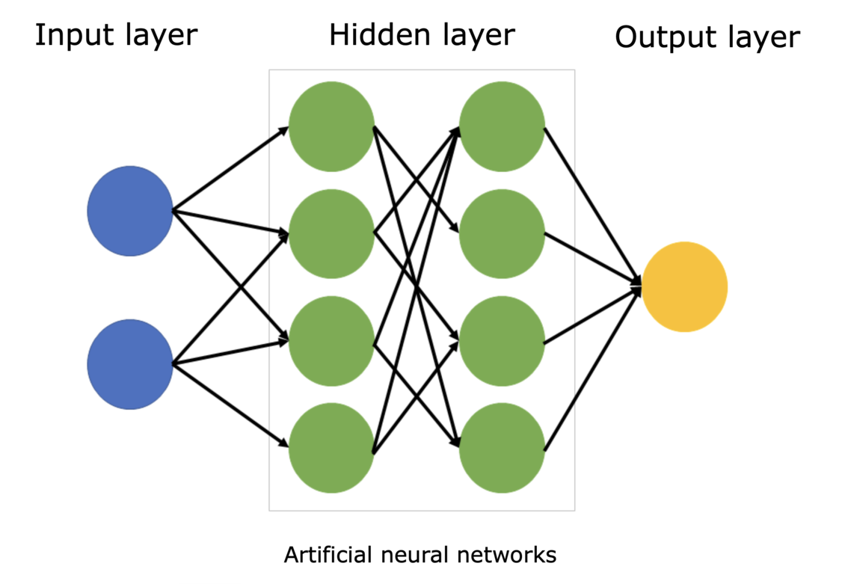
NEURAL NETWORKS
Neural networks are deep learning models that mimic the working of a human brain.
Consists of one input layer,hidden layers and one output layer.
Each layer has nodes called neurons which are interconnected.
Neurons have weights and biases(w,b).
The layers are connected and outputs of one layer become the inputs for the next layer.
If a layer has ‘n’ neurons,it gives ‘n’ outputs.

Slide 23
Activation functions are used to calculate the output of a neuron.
Eg: Sigmoid function,softmax,ReLu
It is recommended to use ReLu function in the hidden layers.
Forward propagation: Data is fed into the model to train it, in the forward direction.
Backward propagation: Computing the derivatives in backward direction to fine tune the weights and improve accuracy.

Slide 24
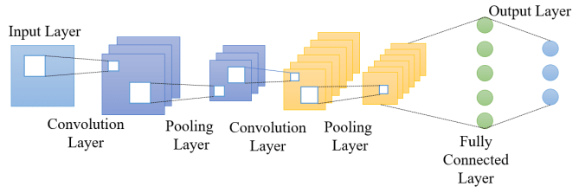
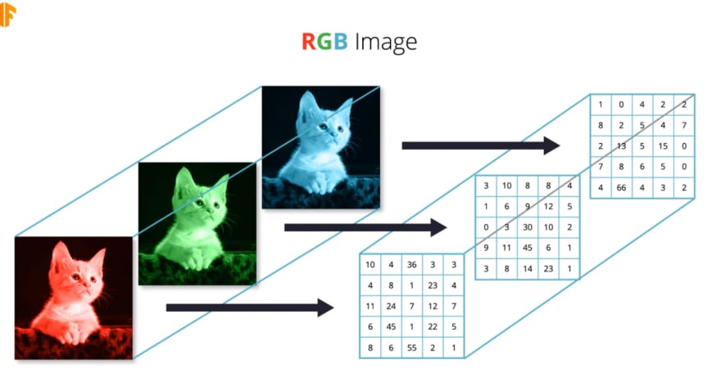
CONVOLUTIONAL NEURAL NETWORK
(CNN)
CNN is primarily used for image classification and object detection tasks.
Contains convolutional,pooling and fully connected layers.
The convolutional layers apply filters(kernels) to the input image to extract features.
The outputs of the above layer are known as feature maps
Pooling layer is used for downsampling feature maps where it keeps only the important parts.
Common types of pooling: Max pooling,average pooling.

Slide 25
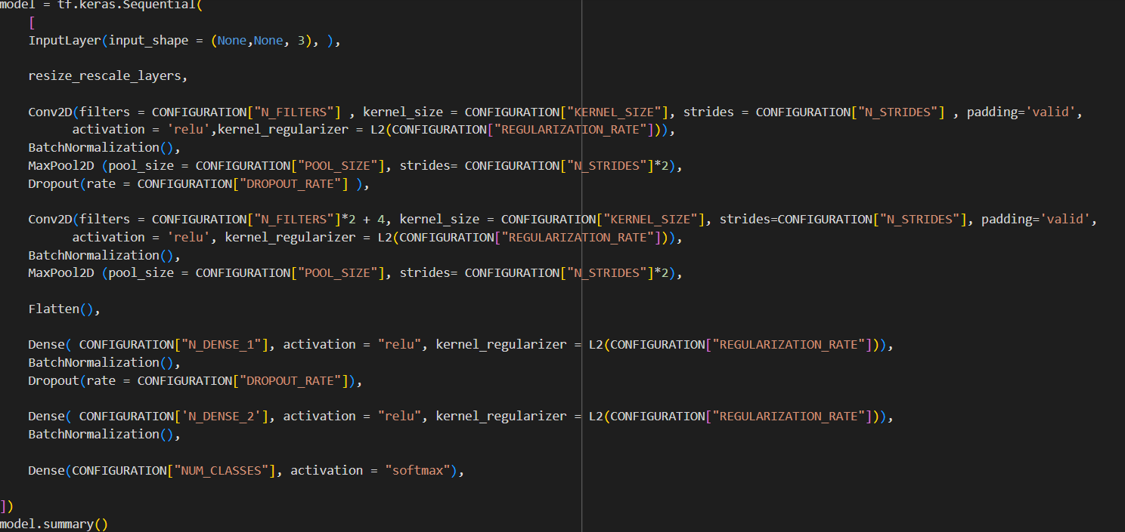
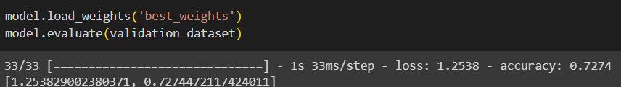
After convolution and pooling,the resulting layer is flattened to a one dimensional vector and passed to the fully connected layer.
The fully connected layer computes the final classification/regression task.
The output layer gives the final output.

Slide 26
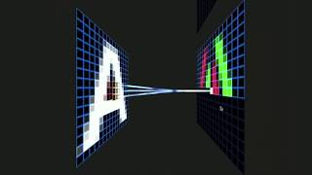

Slide 27
SUMMARY
INTRODUCTION TO DATA SCIENCE AND MACHINE LEARNING
MACHINE LEARNING LIFE CYCLE
METRICS FOR MODEL EVALUATION
SUPERVISED,UNSUPERVISED LEARNING
EXPLORED VARIOUS ML AND DEEP LEARNING ALGORITHMS

Slide 28
QUIZ RULES - DON’T MISS THE OPPORTUNITY
The quiz will start at 9.45 pm SHARP
ALL THE PARTICIPANTS will have to join the quiz. The name that you should provide while joining the quiz should be of this format:
Firstname_RegistrationNo
(It is not case sensitive but underscore (_) is compulsory.

Slide 29
Participants have to join the quiz USING THE LINK/CODE that will shared in a while.
The average of the scores will be taken per team. If all the team members do not attend the quiz, then marks won’t be considered.
The top three teams winning the quiz will be awarded extra scores and will have a head start for the datathon that will be held tomorrow.
NOTE: Register in the platform (name field) using this format: FirstName_RegNo
ALL THE BEST!

Slide 30
THANK YOU!
BY DSC RESEARCH DEPARTMENT:
K Nanditha (Research Head)
K V Hitesh Krishna
Isshaan Singh
Amrutha P

